Slide 1


Walchand College Of Engineering,Sangli
AUTOMATED WHEELCHAIR
FOR DISABLE PEOPLE
Course code:- 6EN341
Sub :- Mini Project 1
Team Members:
1)Shardul Shastri 21410038
2)Atharva Tambade 21410039
3)Vikas Gouda 21410050
Batch - EN3
Group - 3
Guided By: Dr. B.G Patil sir

Slide 2


PRESENTATION FLOW
1 | INTRODUCTION
2 | COMPONENTS REQUIRED
3 | BLOCK DIAGRAM
4 | FLOWCHART
5 | ALGORITHM
6 | PLAN OF ACTION
7 | APPLICATIONS

Slide 3
INTRODUCTION & AIM
The Automated Wheelchair for Individuals with Disabilities project introduces a groundbreaking method of controlling robots: hand gestures.
This innovative approach simplifies and enhances control, enabling remote operation without physical contact or direct visibility.
It's a game-changer in scenarios where traditional control methods pose risks, like hazardous environments or distant locations. This project holds promise not only for wheelchair control but also for various applications in robotics and automation across different domains.

Slide 4
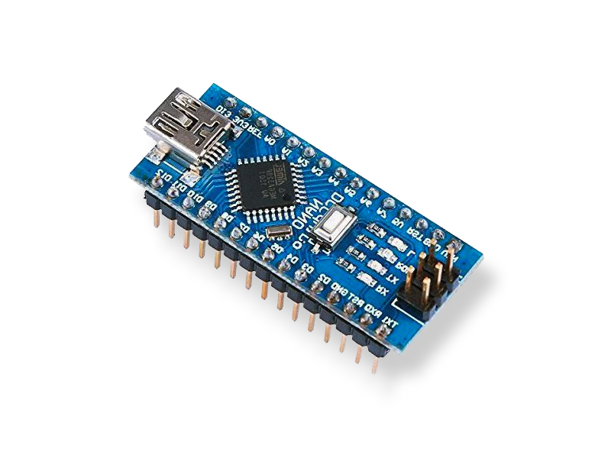
ARDUINO NANO
Processor: ATmega328p running at 16 MHz
Flash Memory: 32 KB
SRAM: 2 KB
Operating Voltage: 5V
Input Voltage: 7-12V
Analog Inputs: 6
Digital I/O Pins: 14 (including 6 PWM outputs)
Batch :- EN3
Group :- 3

Slide 5
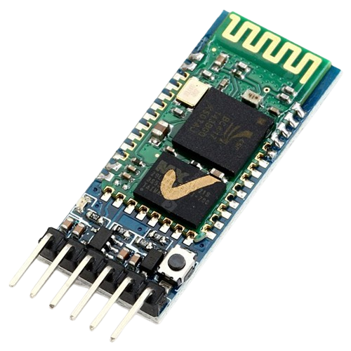
BLUETOOTH HC-50
Bluetooth modules enable wireless device communication over short distances.
They operate as transmitters (master) and receivers (slave).
Devices automatically detect each other when in proximity.
AT commands configure Bluetooth modules for customization.
Trending due to versatility in consumer electronics.

Slide 6
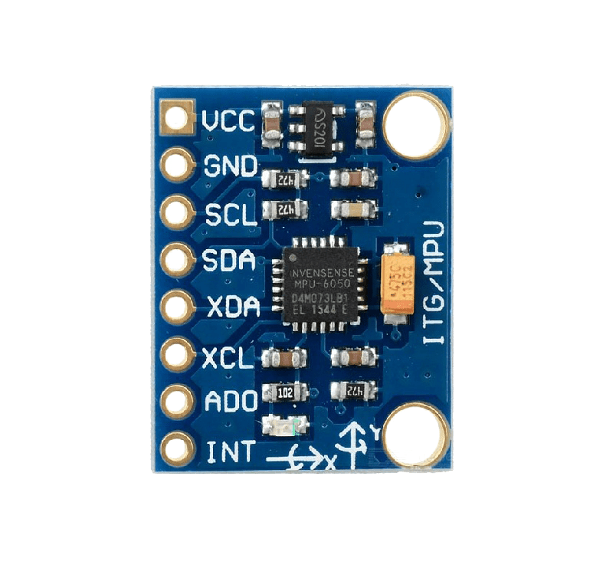
MPU 6050
MPU6050: Sensor measuring motion in 3D via accelerometer and gyroscope.
Common in robotics for motion sensing and control.
Arduino integration with "MPU6050" library for setup, data reading, and calibration.
Hand movements detected through accelerometer's acceleration changes in X, Y, and Z axes.
Outputs signals reflecting direction and intensity of hand movement.

Slide 7
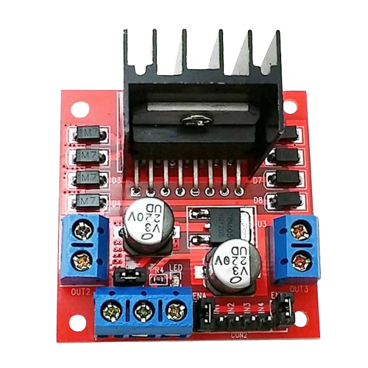
MOTOR DRIVER
Motor driver: Controls speed, direction, and torque of electric motors.
Vital for precise motor control in various applications like robotics and automation.
Essential in robotics, automation, and industrial control systems.
Implementation in the project: Accelerating robot wheels using a motor driver.

Slide 8
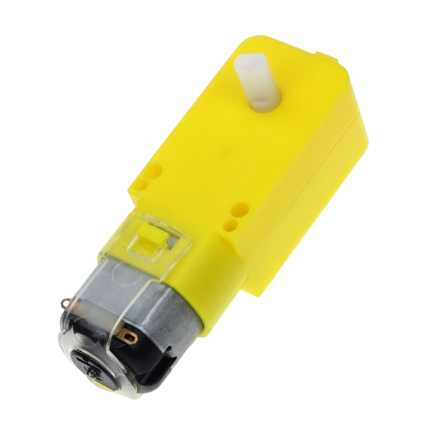
DC MOTOR
A DC (direct current) motor is a type of electric motor that converts electrical energy into mechanical energy through the use of a magnetic field.
DC motors are used for the movement of robot using wheel.

Slide 9
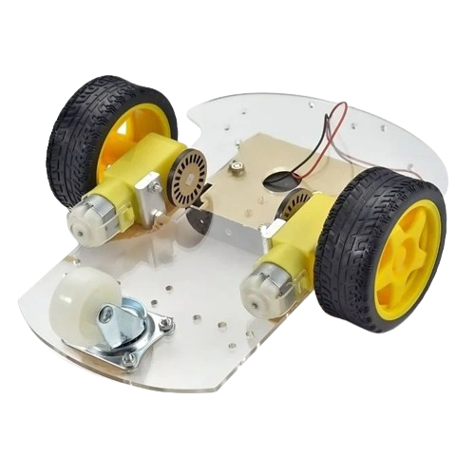
WHEEL AND CHASSIS
Wheels: Round structures made of metal or rubber attached to vehicle axles.
Provide stability, maneuverability, and support to the vehicle.
Chassis: Vehicle framework supporting the body and engine.
Essential components for the robot's main body in the project.
Project requirements: 4 wheels and a chassis for construction.

Slide 10

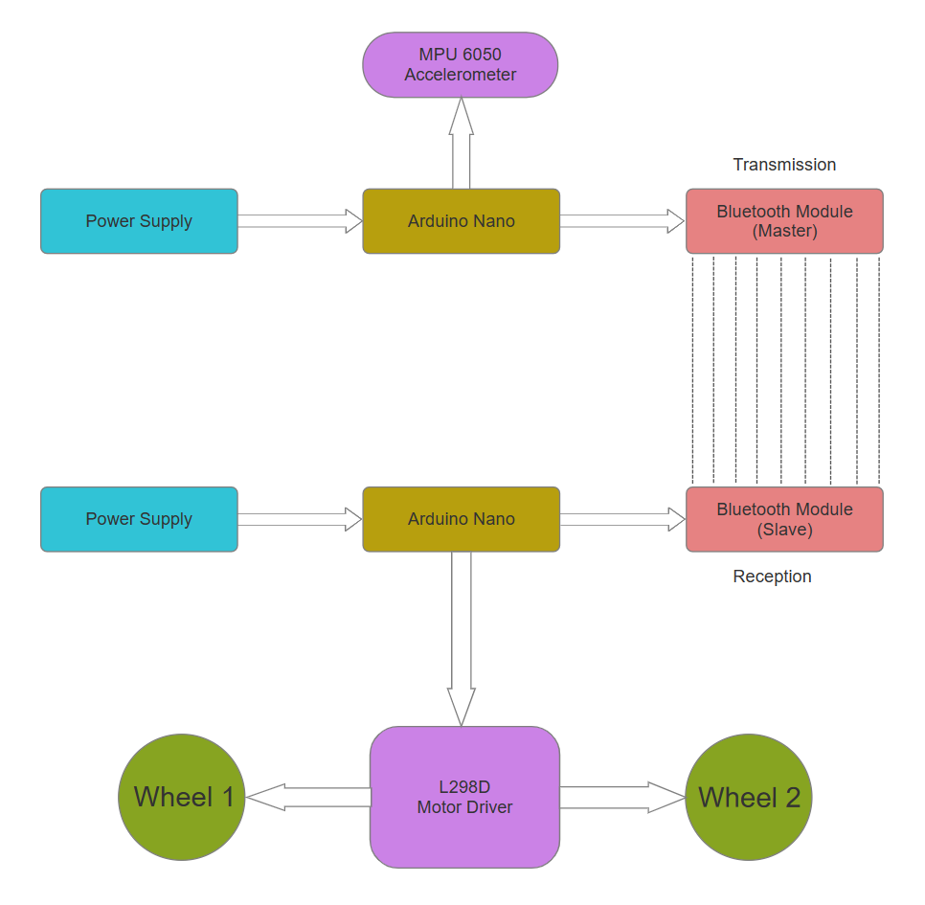
BLOCK DIAGRAM

Slide 11
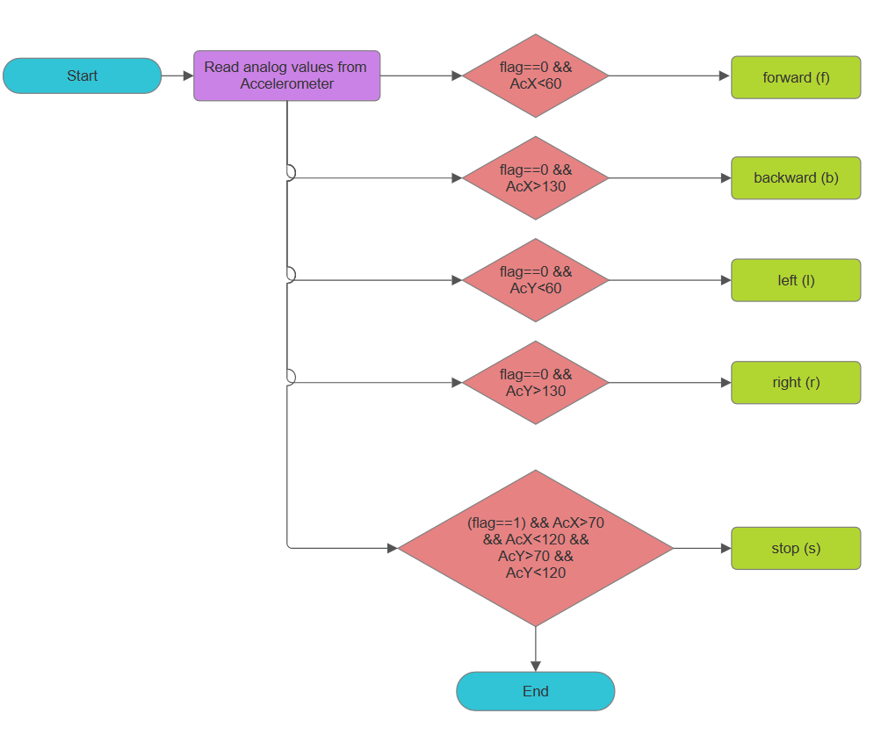
FLOW CHART

Slide 12
HAND CODE ALGORITHIM
Configure Bluetooth module as master module
Start and include all the required libraries of sensor and serial communication
Configure port pins required for serial communication
setup() - Start the serial communication and configure I2C communication for sensor MPU6050
loop() - Read data from the sensor in all three dimensions and map the data
After mapping, depending upon the data send the required characters through serial transmission

Slide 13
ROBOT CODE ALGORITHIM
Configure receiver bluetooth module as slave.
Start and include all the required libraries.
Configure all required port pins and required variables.
In setup() , start the serial reception and configure above port pins as output.
In loop() , write all the required functions for all directions.
When the data is available at reception read the data and depending upon received characters call the required functions.
Eg. -> If ‘f’ is received forward function will be called.

Slide 14
PLAN OF ACTION
WEEK NO. | WORK TO BE COMPLETED | STATUS OF WORK
WEEK NO. 1 | RESEARCH ON DIFFERENT PROBLEMS AND CASE STUDY | COMPLETED
WEEK NO. 2 | SELECTION OF PROBLEM AND INITIATION FOR SOLVING IT | COMPLETED
WEEK NO. 3 | COLLECTION OF INFORMATION | COMPLETED
WEEK NO. 4 | PROJECT PROPOSAL AND VERIFICATION BY MENTOR | COMPLETED
WEEK NO. 5 | MAKING ABSTRACT, SETTING TIME, GOAL AND STRATEGY | COMPLETED
WEEK NO. 6 | REQUESTING FOR COMPONENTS BY LETTER AND COLLECTING IT | COMPLETED
WEEK NO 7 | COMPONENTS TESTING AND VERFICATION FOR USE | COMPLETED
WEEK NO. 8 | CONNECTIONS, MOUNTING, SOLDERING AND SOFTWARE TESTING | COMPLETED
WEEK NO. 9 | PROPER SYNCHRONIZED EXECUTION AND CONTROL MANAGEMENT | COMPLETED
WEEK NO. 10 | PROJECT REPORT AND FINAL PRESENTAION AND EXECUTION | COMPLETED

Slide 15
FUTURE SCOPE AND APPLICATION
Surgery: Enables touchless tool manipulation for precise, contamination-free surgery.
Disability Assistance: Empowers disabled individuals to operate devices using simple hand gestures.
Military Use: Enables remote control of robots and drones, bypassing traditional input methods.
Gaming: Utilizes natural hand movements for character control and interaction in gaming.

Slide 16
CONCLUSION
Promise and Potential: Hand gesture control technology offers a promising avenue for natural robot interaction across diverse industries.
Challenges to Overcome: Limitations in range, accuracy, complexity, and susceptibility to interference pose hurdles.
Critical Success Factors: Sensor accuracy, control system simplicity, and user training are pivotal for effective implementation.
Revolutionary Impact: Despite obstacles, this technology stands to revolutionize human-robot interactions, boosting efficiency and safety.
In navigating these challenges and leveraging the strengths, hand gesture control technology holds the key to transforming how we engage with robots, paving the way for a more intuitive, efficient, and safer future.

Slide 17
THANK YOU

